Slide 1



Cardiac MRI Core Lab
PVDOMICS
Deborah H. Kwon, MD
Cleveland Clinic
Director of Cardiac MRI Research
Assistant Professor of Medicine
Cleveland Clinic Lerner College of Medicine/Case Western Reserve University

Slide 2
Disclosures
Deborah H. Kwon, MD
None

Slide 3
Components of PVDOMICs CMR
Time
CMR Technique
0
Cardiac Structure/Function
Optional imaging:
Pre-contrast MOLLI
Pulmonary artery compliance/remodeling
10
15
Rest Perfusion Imaging
Optional imaging:
4D flow
20
30
Valvular Flow
DHE – Myocardial Scar
45
Optional imaging:
Post-contrast MOLLI
50
Notes:
Importantly, all major CMR techniques (e.g., volume and mass assessment with cine imaging, identification and quantification of fibrosis/scarring, quantification of valvular lesions) are not only highly accurate but also very reproducible

Slide 4
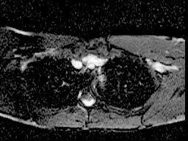
Cardiac Views: axial scout

Slide 5
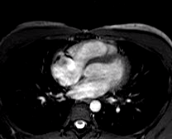
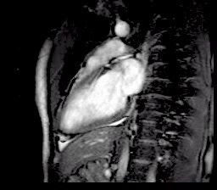
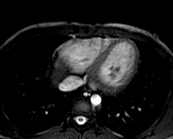
Cardiac Views: Vert. Long Axis (VLA)

Slide 6
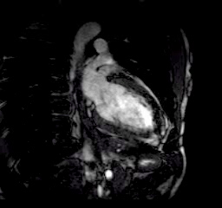
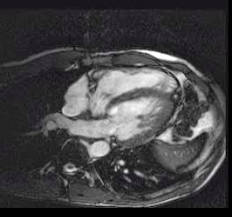
Cardiac Views:
Horizontal Long Axis (HLA)
VLA
HLA

Slide 7
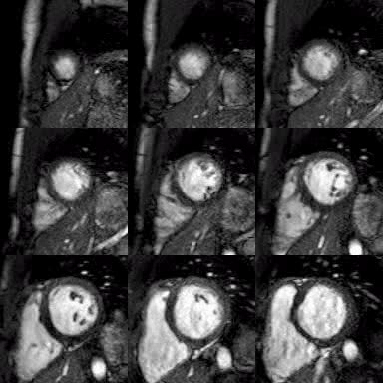
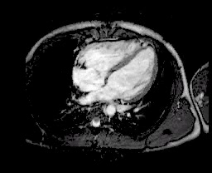
Ventricular Function: short axis stack

Slide 8
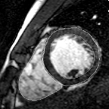
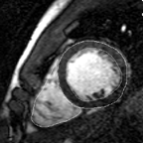
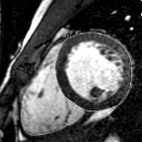
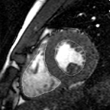
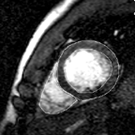
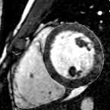
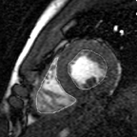
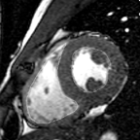
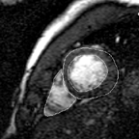
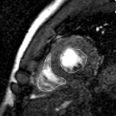
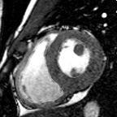
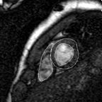
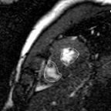
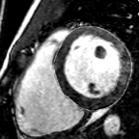
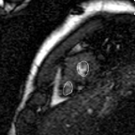
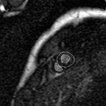
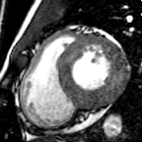
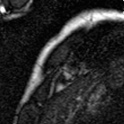
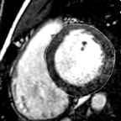
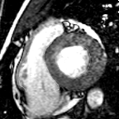
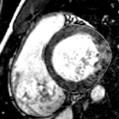
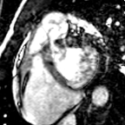
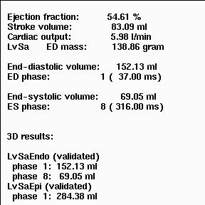
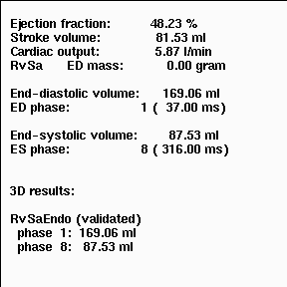
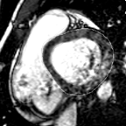
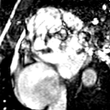
Ventricular Volumes:

Slide 9
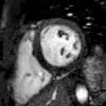
Cardiac Views: 4-chamber

Slide 10
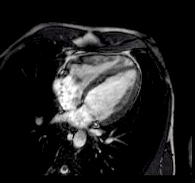
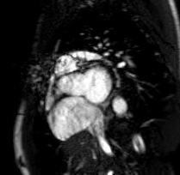
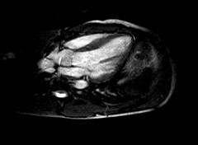
Cardiac Views: LVOT

Slide 11
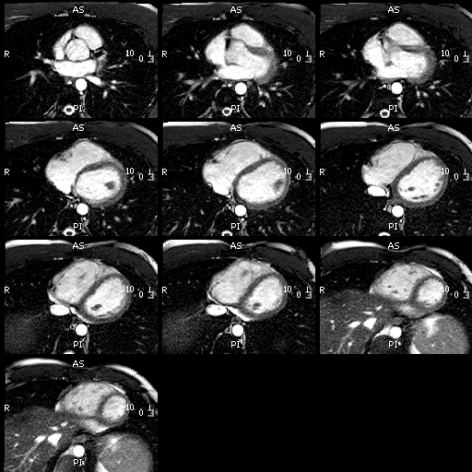
Right Ventricular Function: long axis stack
Notes:
CMR enables the accurate identification of even subtle regional wall motion abnormalities of both the RV and LV.
Moreover, the inherent 3-dimensional nature of CMR makes it particularly well suited to studying the RV, which is difficult to assess with echocardiography because of its complex and
variable morphology. With regard to regional ventricular function, CMR enables the accurate identification of even subtle regional wall motion abnormalities

Slide 12
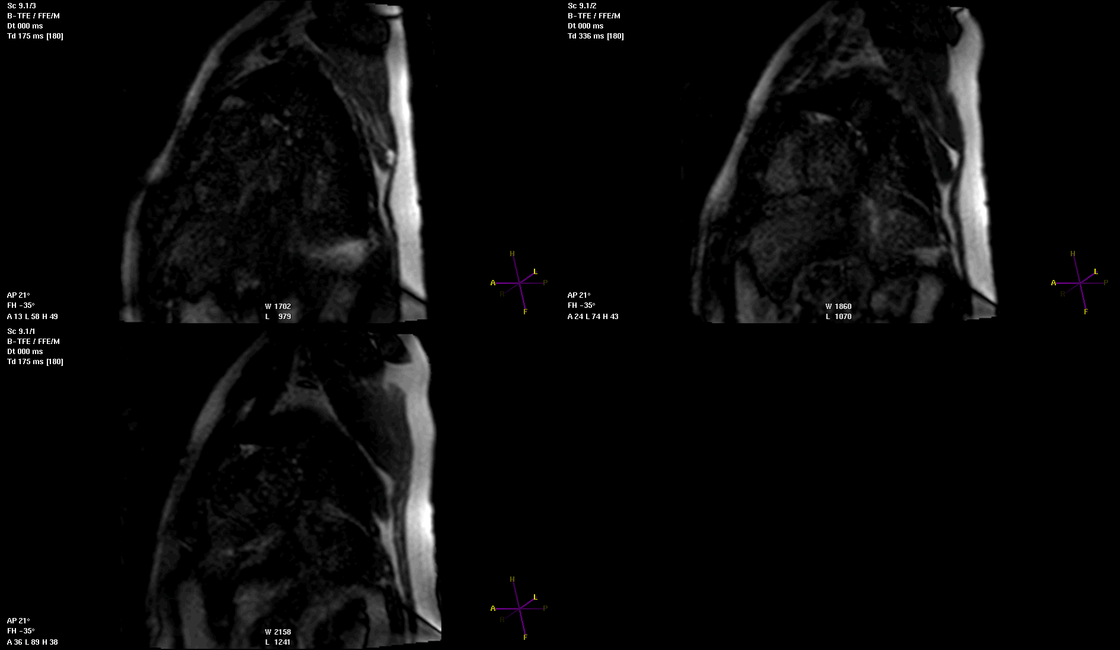
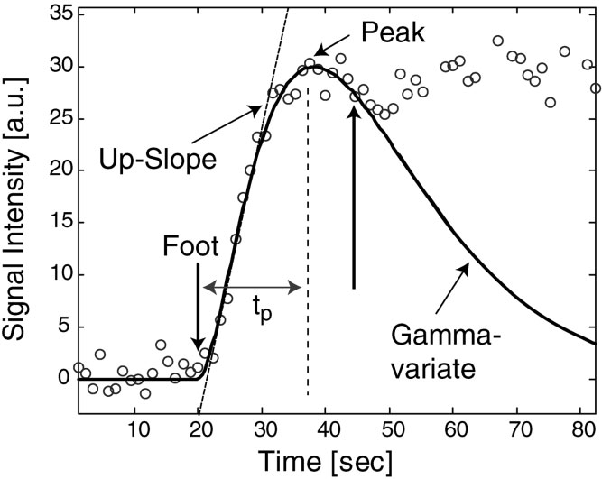
MRI – Rest Perfusion:
Quantitative evaluation of resting blood flow
Jerosch-Herold Journal of Magnetic Resonance Imaging 2004.

Slide 13
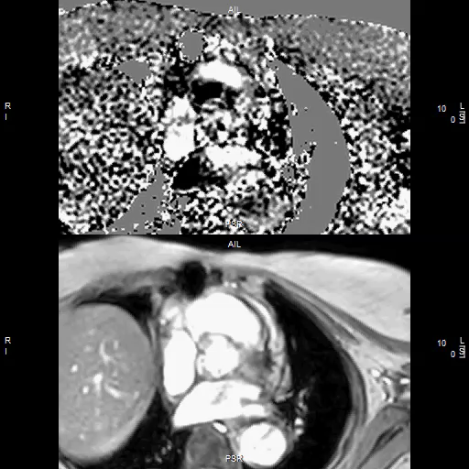
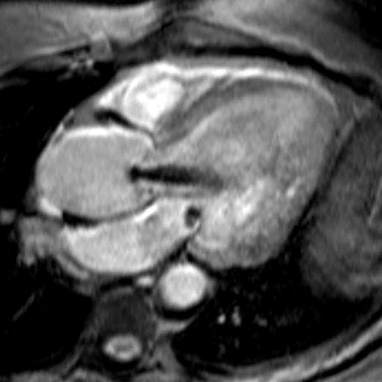
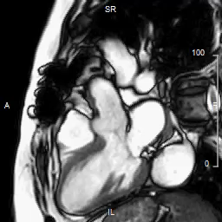
MRI – Phase Velocity Mapping:
Acquire at the level of the aortic root if there is significant aortic regurgitation and/or presence of an ascending aortic aneurysm
Notes:
Obtain at the sinotubular junction if there is significant AI or ascending aortic aneurysm

Slide 14
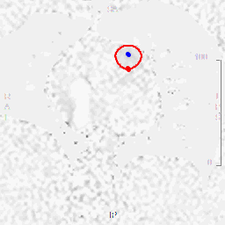
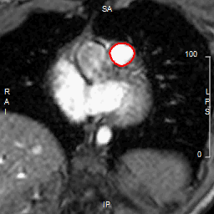
MRI – Phase Velocity Mapping:
Quantitative evaluation of pulmonic flow

Slide 15
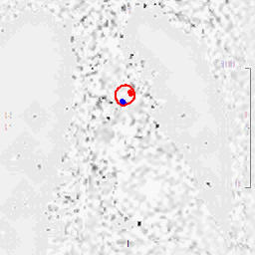
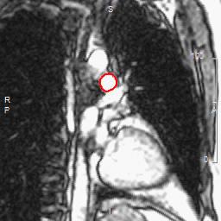
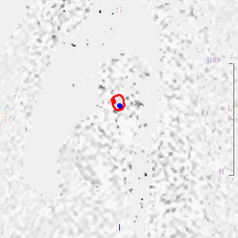
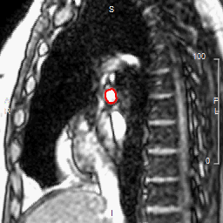
MRI – Phase Velocity Mapping:
Quantitative evaluation of branch pulmonic flow

Slide 16

Delayed Enhancement, “Scar”
Magnetic Resonance Imaging
Myocardial Fibrosis/Scar Assessment
0
Excellent image quality
Spatial resolution
Tissue contrast
No Ionizing Radiation
Contraindications
NSF
Detects viability
- Delayed enhancement

Slide 17
Optional Imaging

Slide 18


T1 Mapping:
Assessment of Diffuse Myocardial Fibrosis
Wong et al. Circulation 2012, Kellman et al. JCMR 2012
Notes:
Figure 5 Examples illustrating cases with diffuse abnormalities in myocardial ECV which are challenging to assess with conventional
LGE. Pre-contrast T1-maps (top row), post-contrast T1-maps (2nd row), late gadolinium enhancement (3rd row), and ECV maps (bottom row) for
patients with various cardiomyopathies: (a) non-ischemic DCM with diffusely elevated ECV and normal appearing LGE, (b) cardiac amyloidosis
with “patchy” LGE enhancement, (c) cardiac amyloidosis with diffusely elevated ECV and globally nulled LGE, and (d) systemic capillary leak
syndrome (SCLS) with globally elevated ECV due to edema and normal LGE.

Slide 19

T1 Mapping:
Assessment of Right Ventricular Myocardial Fibrosis
Kawel Boehm Internation Journal of Cardiovascular Imaging 2014.

Slide 20



Pulmonary Artery Compliance:

Slide 21

Pulmonary Artery Vessel Wall Remodeling:

Slide 22

4D Flow:

Slide 23
Components of PVDOMICs CMR
Time
CMR Technique
0
Cardiac Structure/Function
Optional imaging:
Pre-contrast MOLLI
Pulmonary artery compliance/remodeling
10
15
Rest Perfusion Imaging
20
Optional imaging:
4D flow
30
Valvular Flow
DHE – Myocardial Scar
45
Optional imaging:
Post-contrast MOLLI
50
Notes:
Importantly, all major CMR techniques (e.g., volume and mass assessment with cine imaging, identification and quantification of fibrosis/scarring, quantification of valvular lesions) are not only highly accurate but also very reproducible

Slide 24
Image Acquisition Instructions
Acquire images using consistent imaging parameters. Subject positioning and plane orientations must remain consistent throughout the study.
All subjects will be examined in the supine position.
EKG monitoring will be performed; lead placement is critical. Poorly placed leads result in blurred images and inaccuracies in data. Breath holding must be consistent. Placement of slices can be off as much as 2 cm when inconsistency with breath holds occurs.
Three-plane scout
Localizer: Axial single-shot blood (HASTE) images through the chest
8 mm thick, spaced to cover the aortic arch through the diaphragm
Acquisition during breath-hold is optimal for accuracy.
Localizer: Axial bright blood images through the chest
Single-shot SSFP
8 mm thick slices, spaced to cover the aortic arch through diaphragm
SSFP cine imaging (3 orientations)
Vertical long-axis orientation (2 chamber)
Horizontal long-axis orientation (4 chamber)
Left ventricular outflow tract (LVOT) orientation (3 chamber view)

Slide 25
Image Acquisition Instructions Continued
Common sequence parameters for cine imaging
8-mm slice thickness
2.3 mm minimum spatial resolution (for both phase and frequency encoding directions)
25-35 ms temporal resolution preferred; can be obtained by dropping views per segment captured between R to R intervals.
CMR with Late Gadolinium Enhancement (LGE)
Delayed short axis and long axis views should match slice locations of SSFP cine images. Copying the slice location is an industry standard. Cine images can be ordered to select the end diastolic trigger time by simply scrolling through a short axis image slice location. The selected time for end diastole can be entered into the actual trigger delay time prior to acquiring the delayed image set. This will enable a more accurate representation of the tracing to copy

Slide 26
Thank You

Slide 27





Sydell and Arnold Miller Family
Heart and Vascular Institute
Cleveland Clinic

